Slide 1





Home Irrigation Control System (HICS)
Team Status Report
SRS Review
Belachew
Haile-Mariam
Gautam
Adhikari
Jeremiah
O’Connor
Tung
Vo
Notes:
This presentation demonstrates the new capabilities of PowerPoint and it is best viewed in Slide Show. These slides are designed to give you great ideas for the presentations you’ll create in PowerPoint 2010!
For more sample templates, click the File tab, and then on the New tab, click Sample Templates.

Slide 2
KEY CHANGES MADE TO SRS 1.0 Resulting from Gate review process.

Slide 3
KEY CHANGES MADE TO SRS 1.0
ADDED TEMPERATURE SENSOR (Section 3.14)
ADDED MORE SCREENSHOTS (Section 2.3)
ADDED INTELLIGENT CENTRAL CONTROL UNIT(2.1.1)
DESCRIPTION OF POWERING ON SOIL MOISTURE SENSORS(3.2.3)
ADDED TROUBLESHOOTING GUIDE ON MAINTAINENCE AND SUPPORT (7.5)
ADDED CENTRAL CONTROL UNIT (SECTION 2.1.1)
CLARIFIYING WEB SERVICES/ DATABASE (SECTION 2.1.2,3.10 )
EXPLAINED CONTROL UNIT HOUSING CONSTRAINTS (SECTION 4.1.3)

Slide 4
CUSTOMER REQUIREMENT
ADDED TEMPERATURE SENSOR (Section 3.14)
WHY?
Temperature may be near or below freezing.
No need of watering in this temperature.
Water might freeze and the hose might burst.

Slide 5
NEW MOCKUP (Screenshots)
ADDED MORE SCREENSHOTS (Section 2.3)
WHY?
To visualize how these looks like:
Region creating dialogue
User settings Interface
Administrator settings.

Slide 6
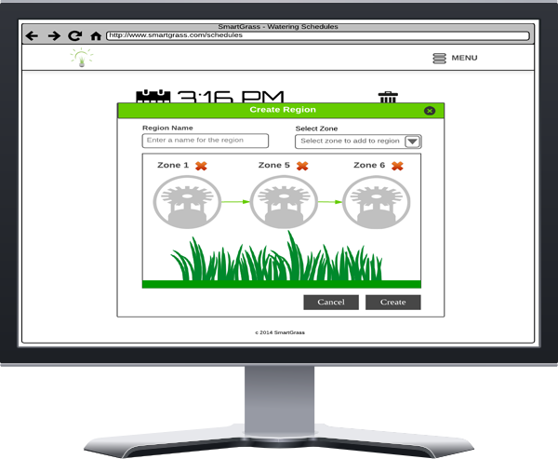
NEW MOCKUP (Screenshots)
Region creating dialogue

Slide 7
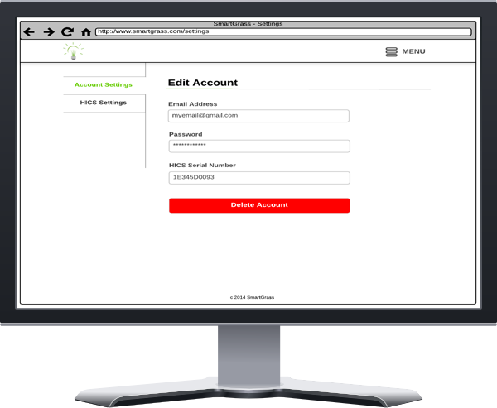
NEW MOCKUP (Screenshots)
User settings Interface

Slide 8
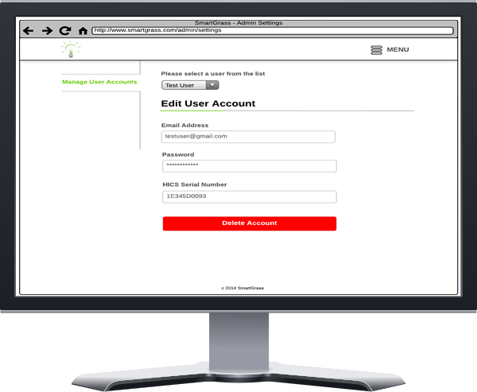
NEW MOCKUP (Screenshots)
Administrator settings

Slide 9
FEATURE AND FUNCTION
ADDED INTELLIGENT CENTRAL CONTROL UNIT(2.1.1)
WHY?
Missing Central Control Unit on SRS 1.0
Intelligent Central Control Unit does the main function.

Slide 10
POWERING SOIL SENSORS
DESCRIPTION OF POWERING ON SOIL SENSORS (3.2.3)
WHY?
Power must be provided to the soil moisture sensors via the Central Control Unit

Slide 11
TROUBLE SHOOTING GUIDE
ADDED TROUBLESHOOTING GUIDE ON MAINTAINENCE AND SUPPORT (7.5)
WHY?
Troubleshooting guide is crucial for maintaining the product.
Intelligent Central Control Unit does the main function.

Slide 12
INTELLIGENT CENTRAL CONTROL UNIT
ADDED CENTRAL CONTROL UNIT (SECTION 2.1.1)
WHY?
Missing Central Control Unit on SRS 1.0 named as “Intelligent Central Control Unit”.
Intelligent Central Control Unit does the main function.
So it’s required on Features and Functions section 2.1.1

Slide 13
WEB SERVICES/ DATABASE MANAGEMENT
MADE THE STATEMENT CLEAR (SECTION 2.1.2,3.10 )
WHY?
It was confusing where data is stored and communicates.
Explained that HICS web application provides a web service.
Web service communicates with HICS to get readings from sensors that will be stored in the web database.

Slide 14
CONTROL UNIT HOUSING
EXPLAINED CONSTRAINTS (SECTION 4.1.3)
WHY?
It was confusing where data is stored and communicates.
Explained that HICS web application provides a web service.
Web service communicates with HICS to get readings from sensors that will be stored in web database.

Slide 15
PRODUCT DESIGN STATUS

Slide 16
ARCHITECHUTE DESIGN
Research on Hardware selection
Base Level Design
Hardware To Use

Slide 17
WHAT’S NEXT?
More Research and planning
Modular Design
Work division
Scheduling
Meeting with Sponsor
Taking his advise on design

Slide 18
Any Questions?
?

